Slide 1
TOPIC:
Stack Organization and Instruction Format
(Lecture 18)
By – Dr Anchal Thakur (Asst. Professor, DICE)

Slide 2
Introduction
Stack is also known as the Last In First Out (LIFO) list. It is the most important feature in the CPU. It saves data such that the element stored last is retrieved first. A stack is a memory unit with an address register. This register influence the address for the stack, which is known as Stack Pointer (SP). The stack pointer continually influences the address of the element that is located at the top of the stack.
It can insert an element into or delete an element from the stack. The insertion operation is known as push operation and the deletion operation is known as pop operation. In a computer stack, these operations are simulated by incrementing or decrementing the SP register.

Slide 3
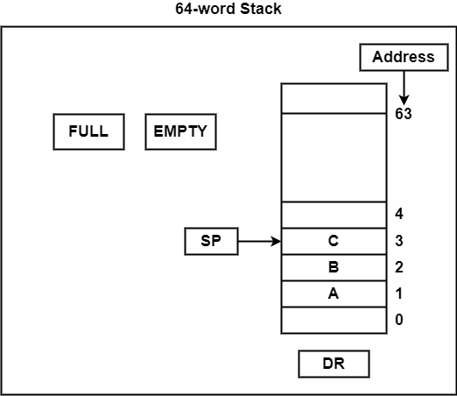
Registered Stacked
Register Stack
The stack can be arranged as a set of memory words or registers. Consider a 64-word register stack arranged as displayed in the figure. The stack pointer register includes a binary number, which is the address of the element present at the top of the stack. The three-element A, B, and C are located in the stack.
The element C is at the top of the stack and the stack pointer holds the address of C that is 3. The top element is popped from the stack through reading memory word at address 3 and decrementing the stack pointer by 1. Then, B is at the top of the stack and the SP holds the address of B that is 2. It can insert a new word, the stack is pushed by incrementing the stack pointer by 1 and inserting a word in that incremented location.

Slide 4
Instruction Format
A computer performs a task based on the instruction provided. Instruction in computers comprises groups called fields. These fields contain different information as for computers everything is in 0 and 1 so each field has different significance based on which a CPU decides what to perform. The most common fields are:
Operation field specifies the operation to be performed like addition.
Address field which contains the location of the operand, i.e., register or memory location.
Mode field which specifies how operand is to be founded.
Instruction is of variable length depending upon the number of addresses it contains. Generally, CPU organization is of three types based on the number of address fields:
Single Accumulator organization
General register organization
Stack organization

Slide 5
Continue..
In the first organization, the operation is done involving a special register called the accumulator.
In second on multiple registers are used for the computation purpose.
In the third organization the work on stack basis operation due to which it does not contain any address field. Only a single organization doesn’t need to be applied, a blend of various organizations is mostly what we see generally.

Slide 6
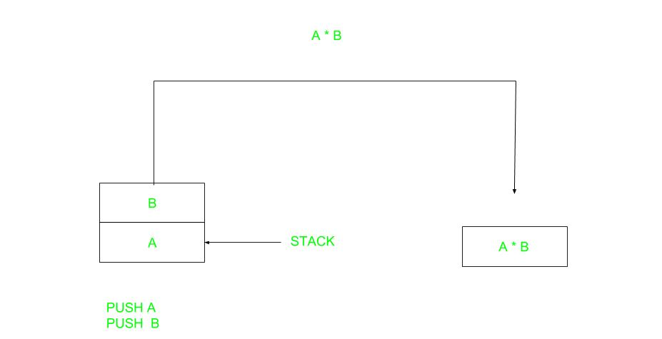
Continue..
Note that we will use X = (A+B)*(C+D) expression to showcase the procedure.
Zero Address Instructions –

Slide 7

Contine..
One Address Instructions –This uses an implied ACCUMULATOR register for data manipulation. One operand is in the accumulator and the other is in the register or memory location. Implied means that the CPU already knows that one operand is in the accumulator so there is no need to specify it.

Slide 8
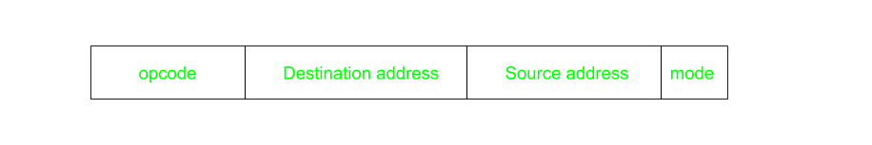
Continue..
Two Address Instructions –This is common in commercial computers. Here two addresses can be specified in the instruction. Unlike earlier in one address instruction, the result was stored in the accumulator, here the result can be stored at different locations rather than just accumulators, but require more number of bit to represent address.

Slide 9
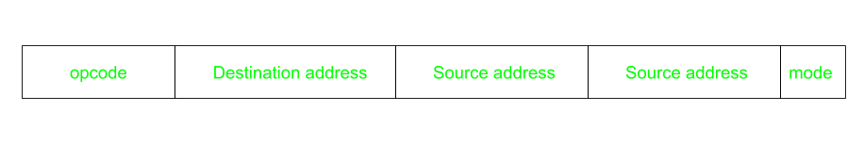
Continue..
Three Address Instructions –This has three address field to specify a register or a memory location. Program created are much short in size but number of bits per instruction increase. These instructions make creation of program much easier but it does not mean that program will run much faster because now instruction only contain more information but each micro operation (changing content of register, loading address in address bus etc.) will be performed in one cycle only.

